Slide 1
DETECTING PLANT GROWTH STAGES BY MACHINE LEARNING
EE5003
A0279396E - Wu Yutong
Dept of Electrical & Computer Engineering, NUS

Slide 2

Table of contents
01 Project background and objectives
02 Dataset creation
03 Develop model detecting different growth stages
04 Develop model detecting abnormal leaves
05 Method comparison and Summary

Slide 3

Project background and objectives
01
1. Project background
2. Project objectives

Slide 4

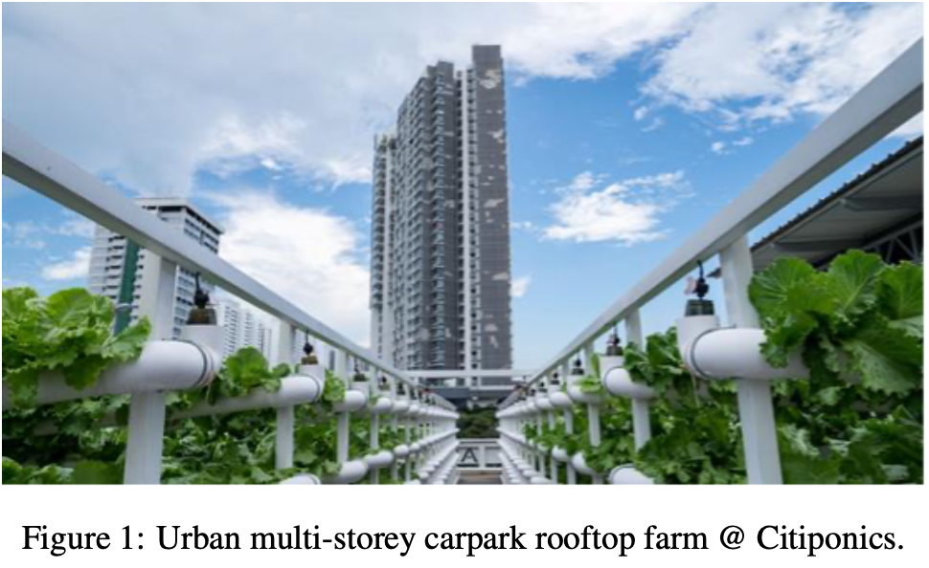
Project background
When it comes to locating places for farming, commercial centers and HDB multi-story parking lots’ rooftops are viable options for productive farms.
Figure 1 shows a 1900 square meter urban vertical farm built by Citiponics on the roof of an HDB parking lot.
A controlled camera and multi-sensor system can track the growth status of plants in real time for timely harvesting, and can also monitor and adjust variables such as temperature and humidity in the planting area to maintain the ideal conditions for plant growth.

Slide 5
Project objectives
• Acquire Well-Labeled Datasets: Well-labeled dataset of lettuce growth stages, including plant images from different growth stages, as well as well-labeled dataset of abnormal leaves, which includes categories of diseased lettuce.
• Develop Deep Learning Models: Design algorithm models that can accurately detect and classify plant growth stages and detect abnormal leaves.
• Visualize Detected Results: Visualize the detection results and present the detected growth status in a clear and interpretable manner.

Slide 6
Dataset creation
02
1. Lettuce Growth Stages Dataset
2. Abnormal Leaves Dataset

Slide 7
Grow lettuce
Growing lettuce in Singapore requires consideration of the tropical climate and high temperatures in the region. Choose heat-resistant lettuce varieties, such as loose leaf type. Due to the rainy season in Singapore, there is insufficient natural light and LED lights are needed to supplement the lighting. Select the hydroponic approach because lettuce grown hydroponically grows more quickly and is more resilient than lettuce grown in soil. The aperture of the cultivation board is 3.2cm, and the planting density is 10cm by 10cm; Apply the soaked seeds directly onto the surface of the sponge block, and after germination, insert the cultivated seedlings into the holes of the cultivation board. Regularly change the nutrient solution.
Take photos at a fixed point every day to make sure that the light and angle are the same, and the background is clean.

Slide 8
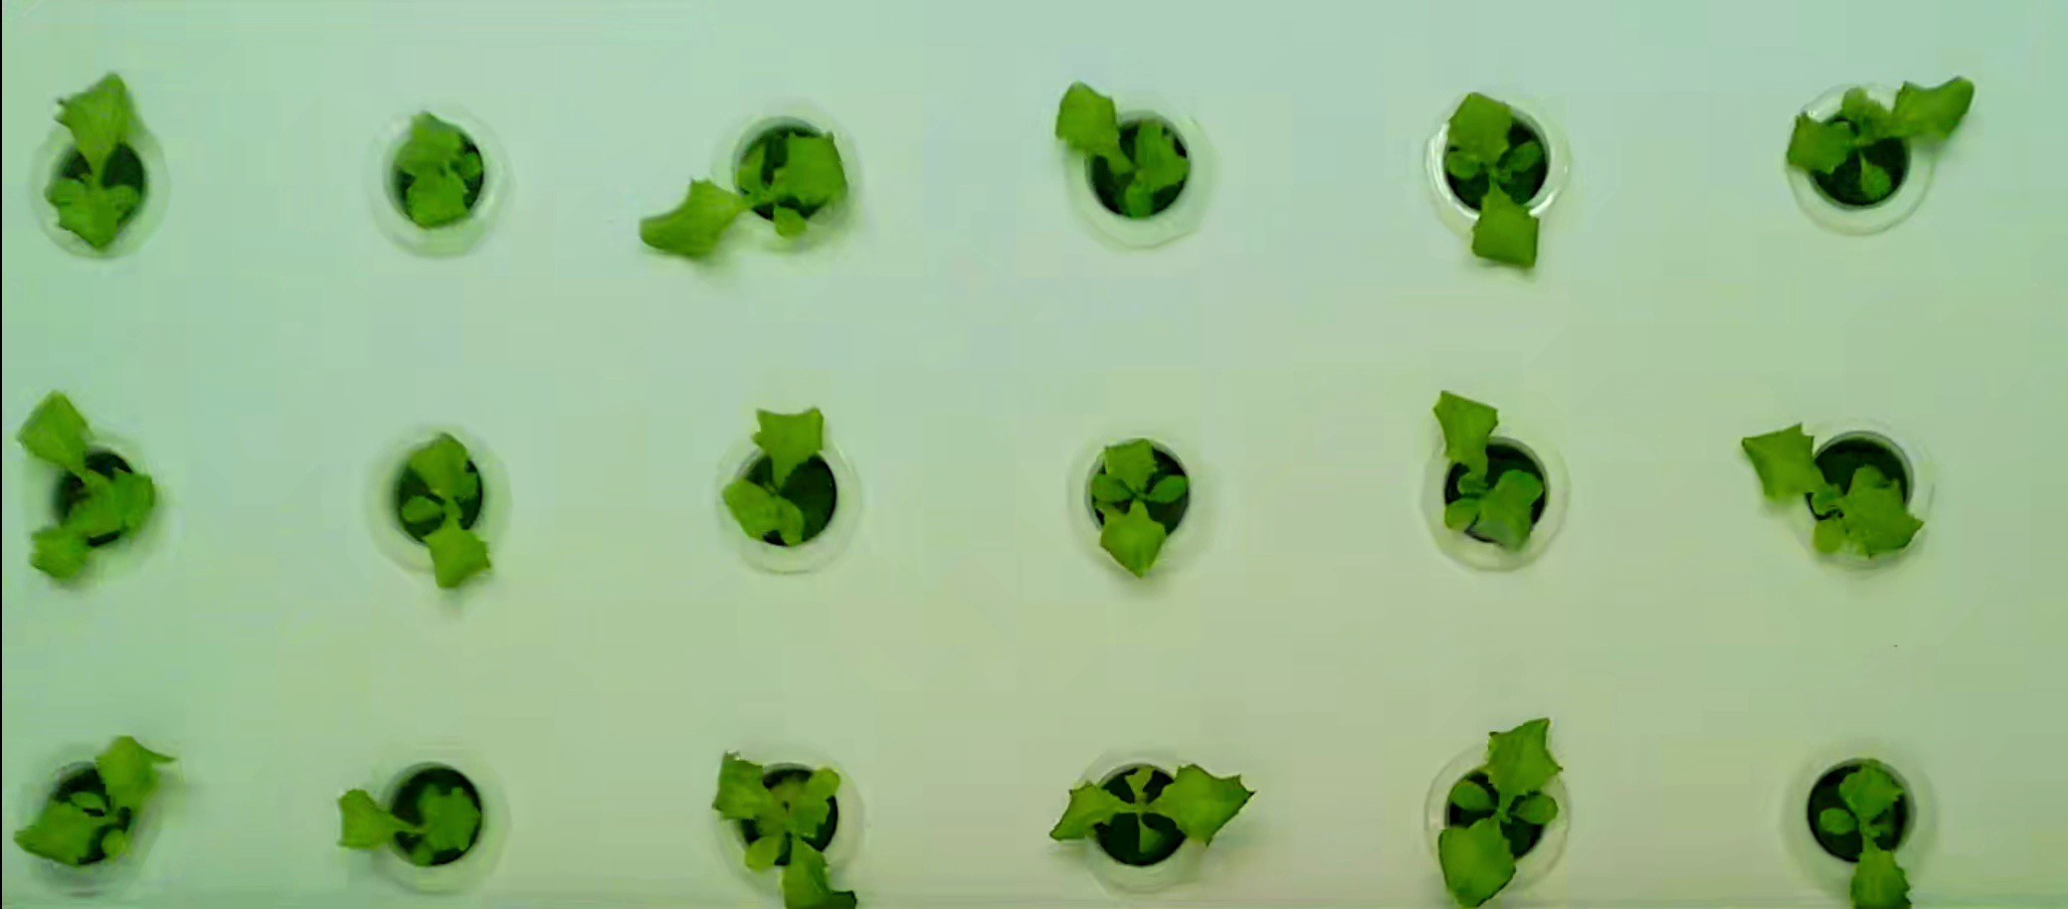
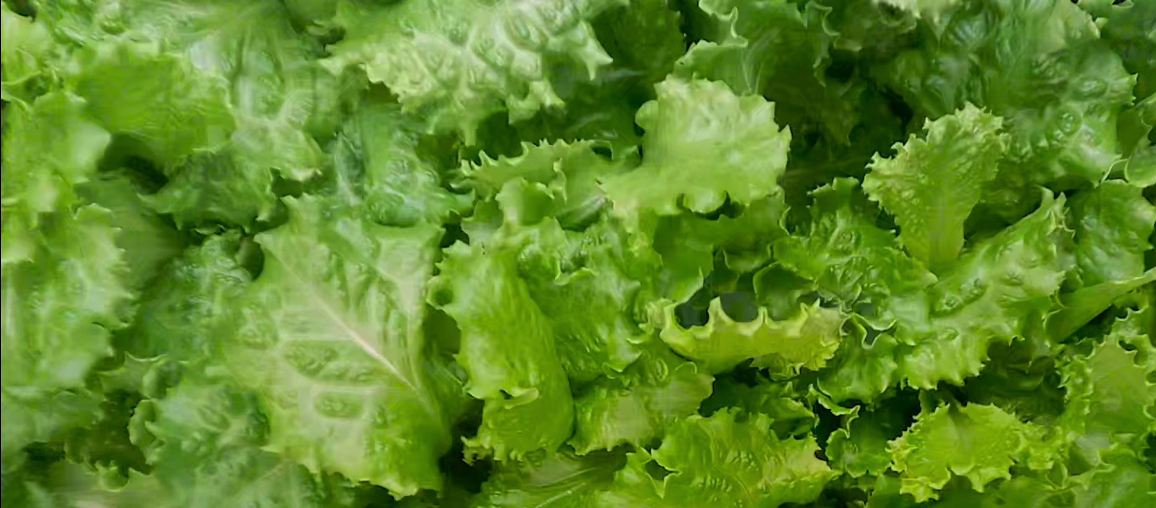
Photos of lettuce planted

Slide 9

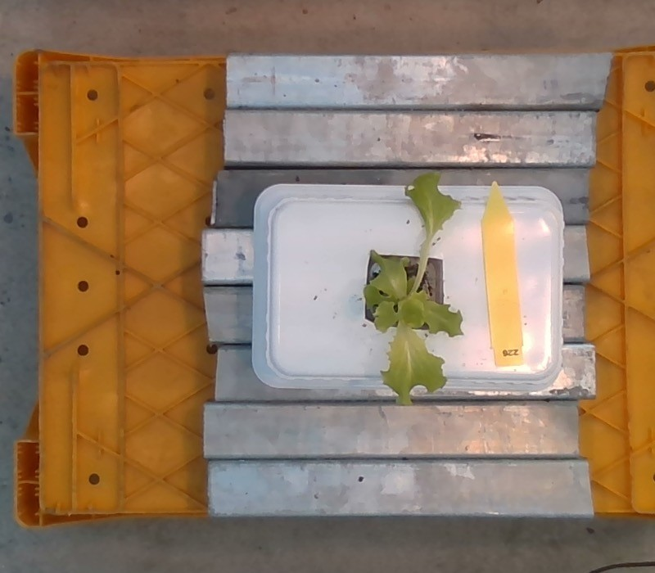
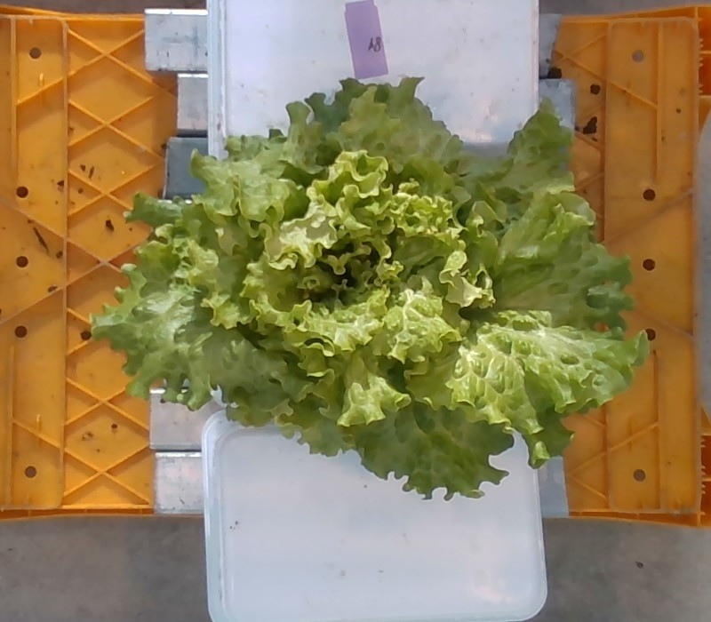
Open source lettuce database
Reference: S. (Silke) Hemming; H.F. (Feije) de Zwart; Elings, A. (Anne); monique bijlaard; Bart Marrewijk, van et. al. (2021): 3rd Autonomous Greenhouse Challenge: Online Challenge Lettuce Images. Version 1. 4TU.ResearchData. dataset. https://doi.org/10.4121/15023088.v1

Slide 10
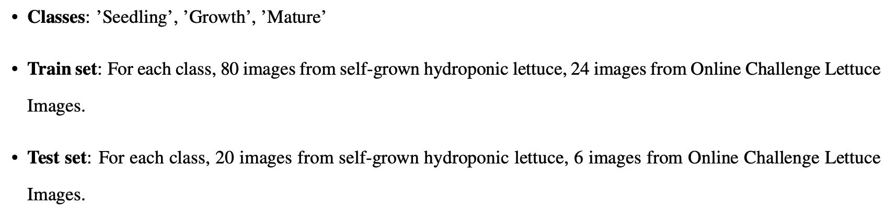
Lettuce Growth Stages Dataset
The existing dataset on the growth stage of lettuce is insufficient to meet the data requirements of this project. In order to improve the dataset, the final dataset consists of self-grown hydroponic lettuce and Online Challenge Lettuce Images from open source 3rd Autonomous Greenhouse Challenge.

Slide 11
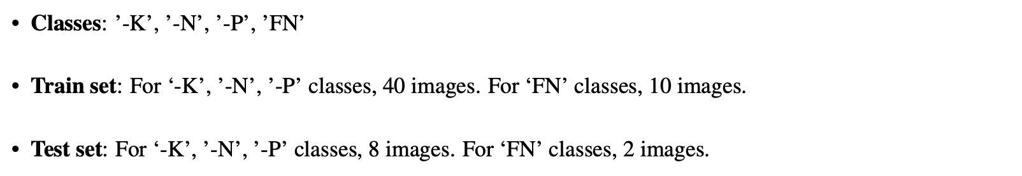
Abnormal Leaves Dataset
Use the Lettuce NPK dataset which contains the following categories of Diseased lettuce: Fully Nutritional(’FN’), Nitrogen Deficient(’-N’), Phosphorus Deficient(’-P’) and Potassium Deficient(’-K’).
Reference: Ramimalik782.(2023).LettuceNPKDataset.RetrievedfromKaggle:
https://www.kaggle.com/datasets/baronn/lettuce- npk-dataset

Slide 12

03
Develop model detecting different growth stages

Slide 13
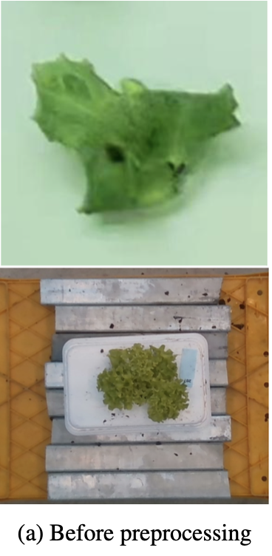
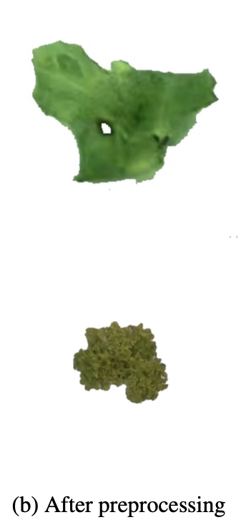
Image preprocessing
Create a binary mask with a specific color range corresponding to lettuce leaves in the HSV color space. Then, use morphological operations to refine the mask and extract the background area. Finally, separate the lettuce from the background and place it on a white background to generate an image suitable for subsequent processing and analysis.

Slide 14

Histogram of Oriented Gradients (HOG)
Block operation
Divide the input image into blocks. Each block can be 10*10 pixels.
For each pixel in the block we will have one set of oriented gradient information. For 10*10 pixels, we have 100 sets of oriented gradient information.
Descriptor Formation
For each block, we can group the gradients (100 of them) using a histogram with 9 bins. The magnitude influence the height of each bins.
Concatenates the histograms of all blocks in one long vector to form a HOG descriptor.

Slide 15

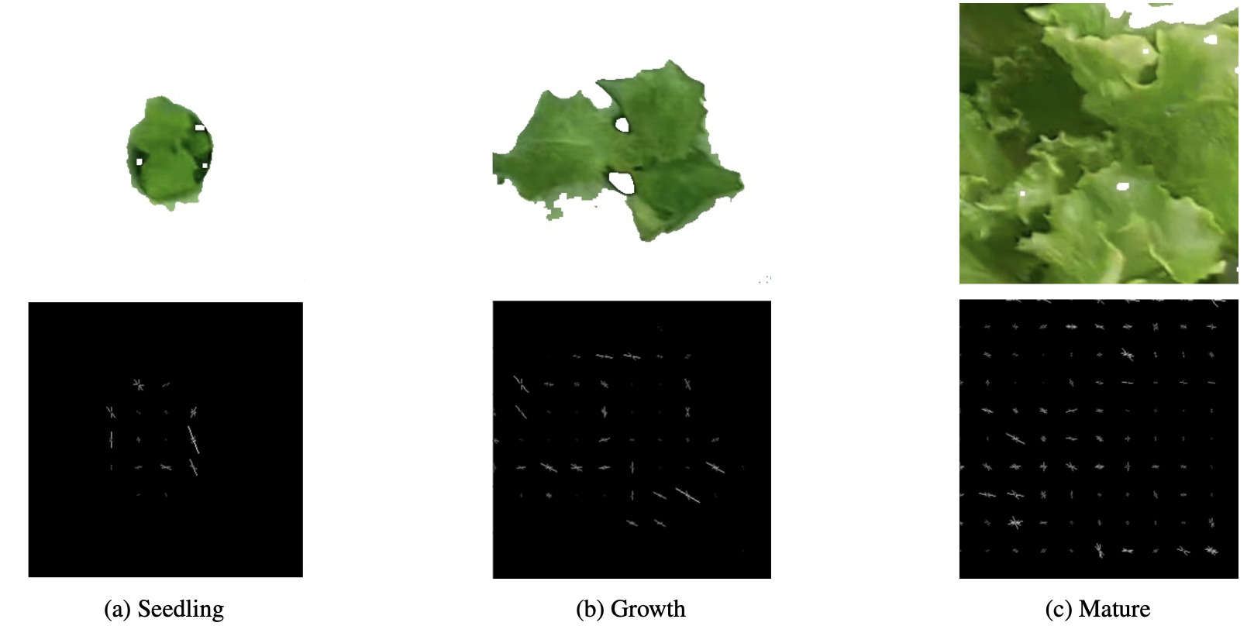
Input image
HOG

Slide 16
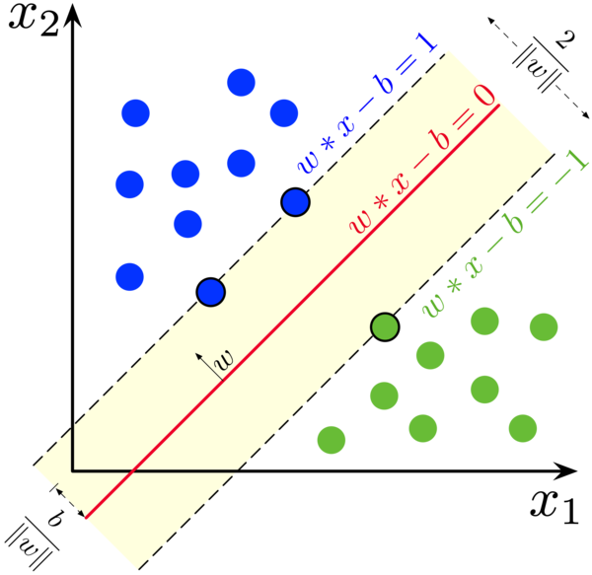
Support Vector Machine (SVM)
SVM aims to find the hyperplane that maximizes the margin, which is the distance between the hyperplane and the nearest data points from each class.
Parameters : kernel type and regularization parameters (C) .
In this project, an SVM classifier with a linear kernel and regularization parameter (C) equal to 1.0 can meet the classification requirements.
Support Vector Machine (SVM) is a universal supervised machine learning algorithm widely used for classification tasks. Its core is to pursue the optimal hyperplane that can effectively separate data points belonging to different categories. When executing SVM, kernel type and regularization parameters (C) are two key parameters that must be defined. For case, linear kernels are suitable for directly segmenting information, while radial basis function (RBF) kernels are more general and allow for complex nonlinear information segmentation. The regularization parameter (C) determines the trade-off between maximizing edges and minimizing classification errors. Lower C emphasizes more attention to edges, which may lead to more misclassification. A higher C value allows for fewer misclassifications, but may result in tighter edges, which may lead to overfitting. In this project, an SVM classifier with a linear kernel and regularization parameter (C) equal to 1.0 can meet the classification requirements.

Slide 17
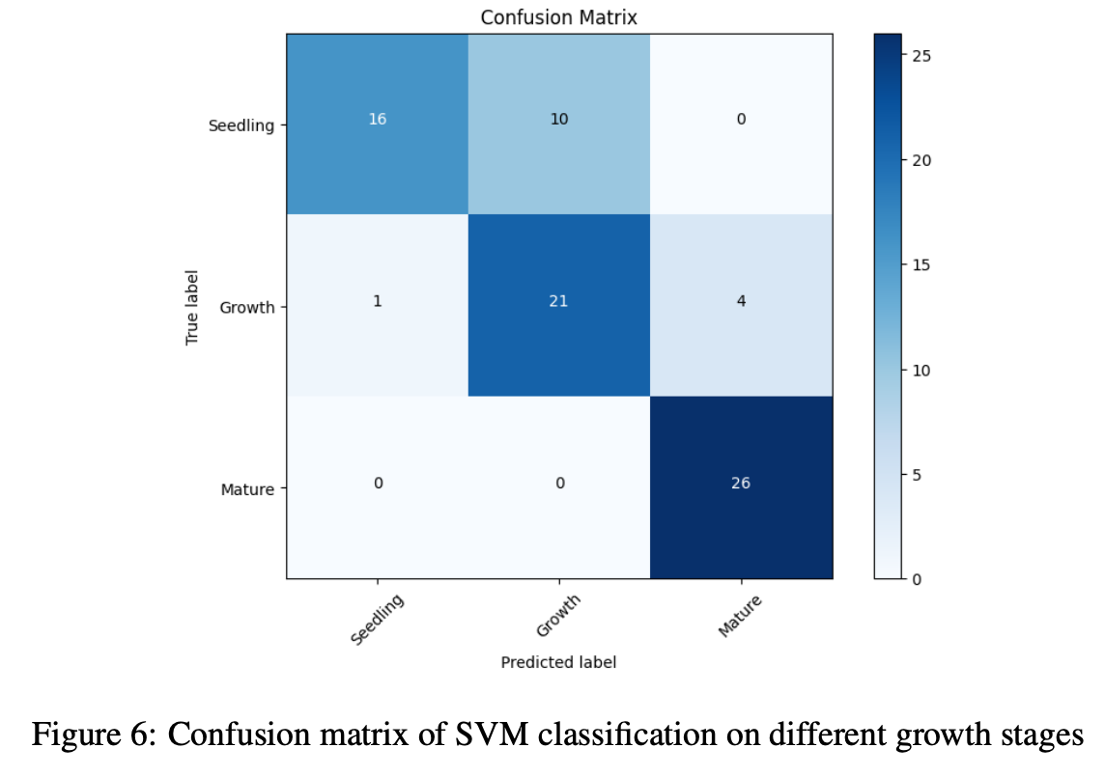
HOG Feature Extraction combined with SVM method
Train model
Use the features captured by HOG, as well as the corresponding labels for the growth stages of each image (such as seedlings, growth, and maturity), to train this Support Vector Machine (SVM) classifier.
Show classification results
Generate a confusion matrix for visualizing the SVM classification performance across different lettuce growth stages classes. The accuracy of SVM classification on different lettuce growth stages is 80.77%.

Slide 18
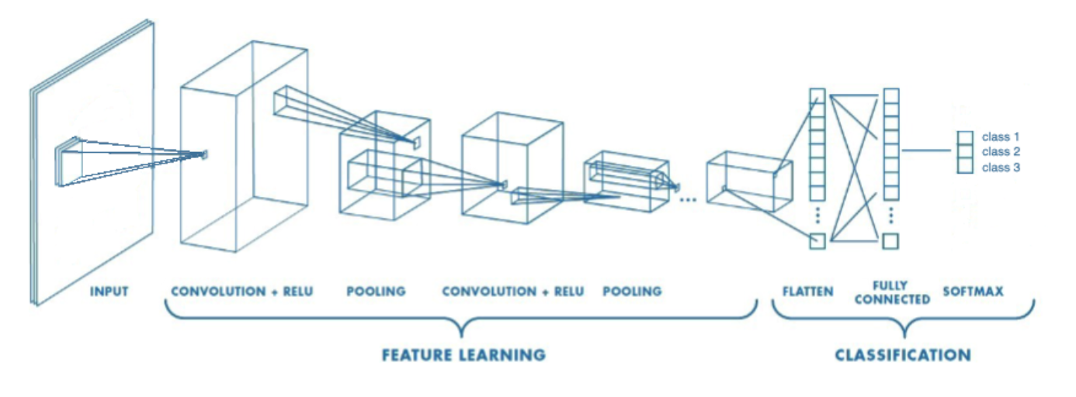
Convolutional Neural Network (CNN) architecture
Convolutional layer applies a learnable filter to the input image, performs convolution operations on the image, and extracts local patterns and features.
After each convolutional layer, placing the ReLU activation function can enable the model to capture further complex structures present in the image.
Max-pooling layer downsamples the feature map by selecting the maximum value within each pooling region. This reduces the computational complexity of the model and helps to reduce the risk of overfitting.
The output from the convolutional layers is flattened and passed through fully connected layers.

Slide 19
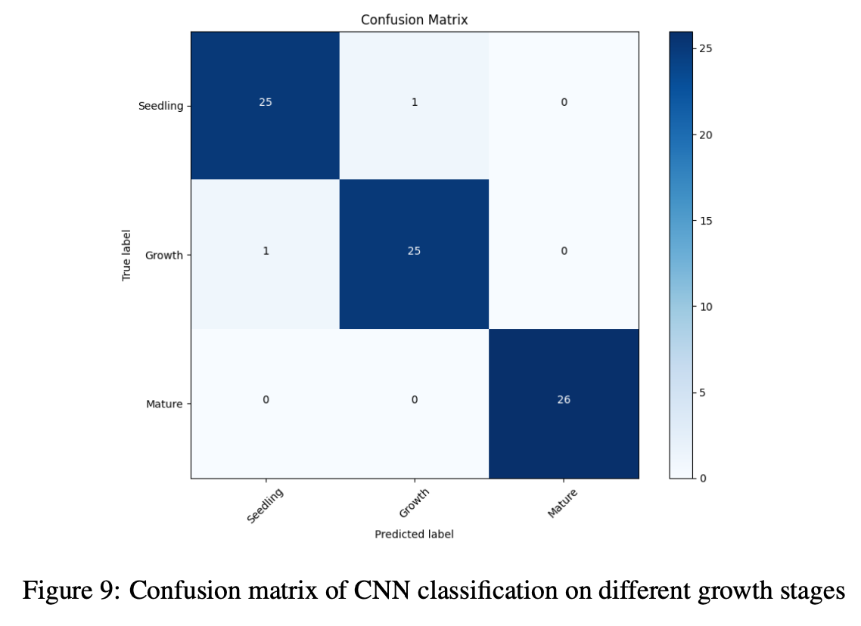
CNN classification on different growth stages
Train model
The CNN is optimized using the Adam optimizer with a learning rate of 0.001. The model minimizes the Cross-Entropy Loss function. Through backpropagation, the model iteratively adjusts its parameters to minimize this loss. The model is trained over a specified number of epochs(e.g., 50) using this training loop.
Show classification results
Generate a confusion matrix for visualizing the CNN classification performance across different lettuce growth stages classes. The accuracy of CNN classification on different lettuce growth stages is 97.44%.

Slide 20
Develop model detecting abnormal leaves
04

Slide 21
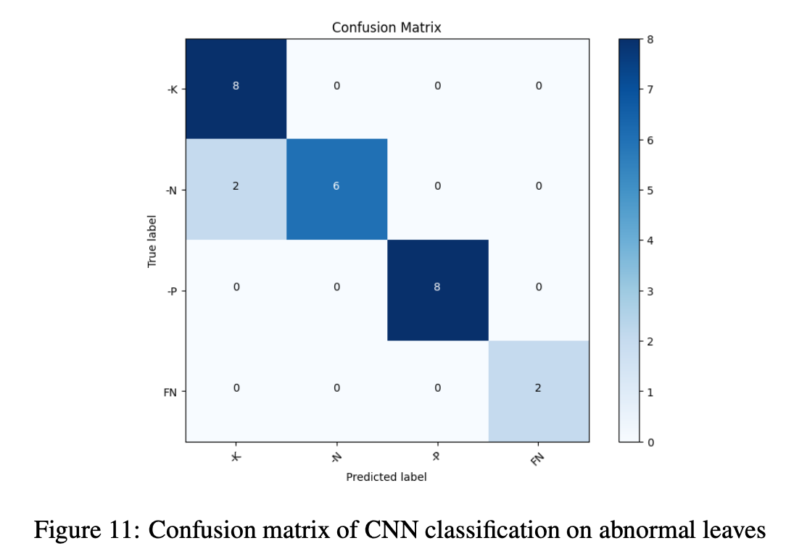
CNN classification on abnormal leaves
Train model
It loads the Lettuce NPK dataset for training, defines the CNN architecture with two convolutional layers and two fully connected layers, trains the model using the Adam optimizer and Cross Entropy loss function
Show classification results
Generate a confusion matrix for visualizing the CNN classification performance across categories of Diseased lettuce. The accuracy of CNN classification on abnormal leaves is 92.31%.

Slide 22
05
Method comparison
and Summary

Slide 23
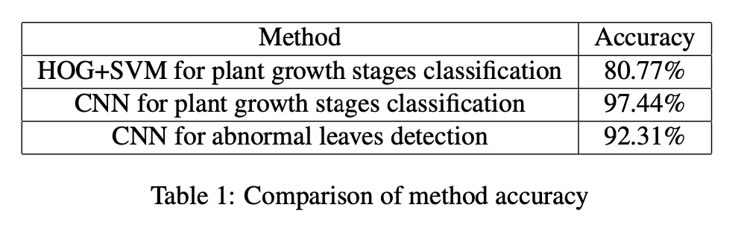
Method comparison
Both traditional computer vision techniques and deep learning algorithms are effective in detecting plant growth stages.
The classification accuracy of Convolutional Neural Network (CNN) models is superior to traditional classification methods that combine Gradient Histogram (HOG) and Support Vector Machine (SVM).
The CNN achieved an accuracy rate of 97.44% for plant growth stages classification and 92.31% for abnormal leaves detection. In contrast, the HOG+SVM approach yielded lower accuracy rates, indicating the superior performance of deep learning methods in this context.

Slide 24
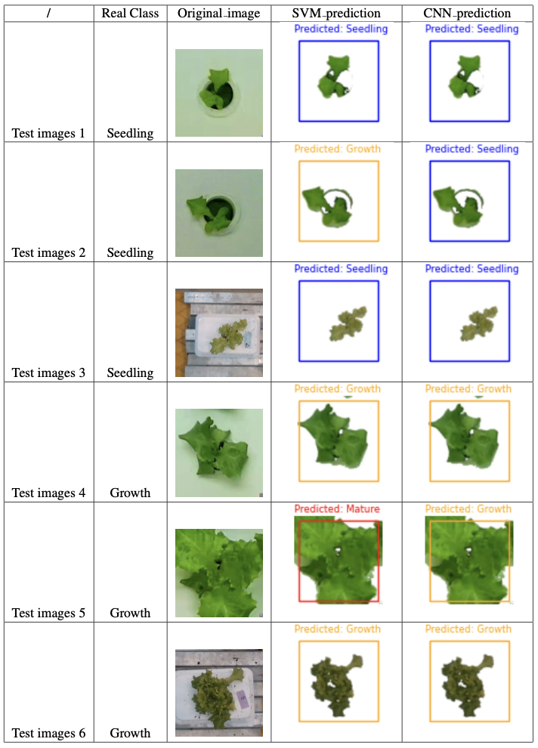
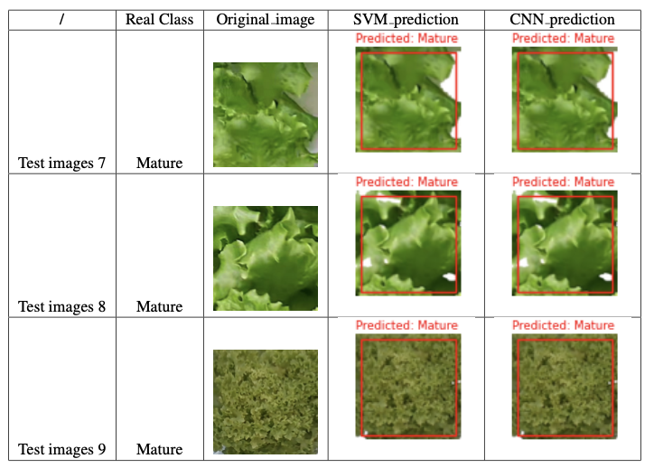
Visualize the detected results
Print the input image and draw different colors and text on it to represent different predicted categories to provides a more intuitive representation of the model classification results.
Randomly select 3 test images for each growth stages class to demonstrate the visualization of growth stages detection results. As we can see, Test images 2 and 5 are correctly classified by CNN, but they are misclassified by the SVM classification.

Slide 25
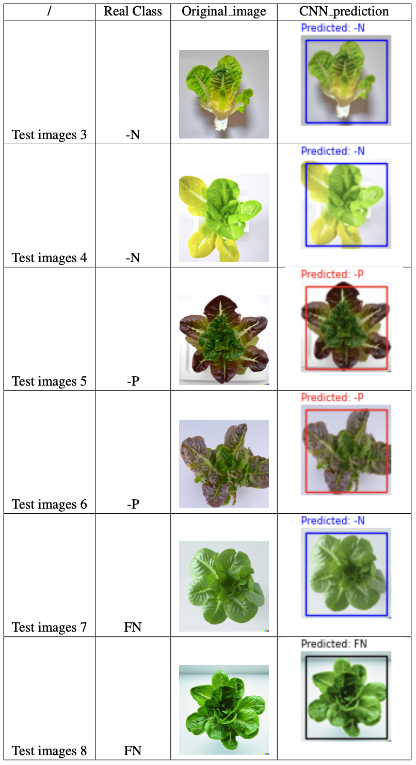
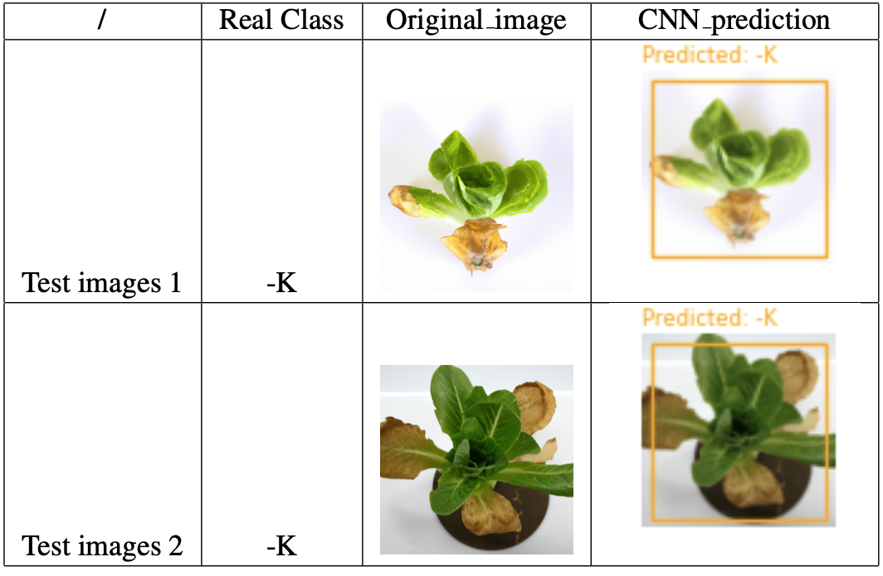
Visualize the detected results
Randomly select 2 test images for each diseased lettuce class to demonstrate the visualization of abnormal leaves detection results. We can observe that, due to the smaller number of ”FN” samples compared to other classes in the Abnormal Leaves Dataset, CNN classification incorrectly classified the fully nutrition Test image 7 as nitrogen deficient. In the mean time, CNN’s classification of other test images in the table is correct.

Slide 26
Summary
This project demonstrates that the AI-based convolutional neural network model can more accurately classify plant growth stages and identify abnormal leaves. The performance of convolutional neural networks is superior to traditional computer vision methods, demonstrating the power of deep learning in dealing with complex image classification problems.

Slide 27
Reference
SFA. (2021). A foodie haven with no food is a recipe for disaster. Food for Thought. Retrieved from https://www.sfa.gov.sg/food-for-thought/article/detail/a-foodie-haven-with-no-food-is-a-recipe-for-disaster.
S. (Silke) Hemming; H.F. (Feije) de Zwart; Elings, A. (Anne); monique bijlaard; Bart Marrewijk, van et. al. (2021): 3rd Autonomous Greenhouse Challenge: Online Challenge Lettuce Images. Version 1. 4TU.ResearchData. dataset. https://doi.org/10.4121/15023088.v1
Ramimalik782.(2023).LettuceNPKDataset.RetrievedfromKaggle:https://www.kaggle.com/datasets/baronn/lettuce- npk-dataset
H. Rachman, Y. Purwanto and C. Setianingsih, ”Detection of Lettuce Plant Conditions Based on Images using Back- propagation Method,” 2022 International Conference on Innovation and Intelligence for Informatics, Computing, and Technologies (3ICT), Sakheer, Bahrain, 2022, pp. 593-597, doi: 10.1109/3ICT56508.2022.9990758.
Gang MS, Kim HJ, Kim DW. Estimation of Greenhouse Lettuce Growth Indices Based on a Two-Stage CNN Using RGB-D Images. Sensors (Basel). 2022 Jul 23;22(15):5499. doi: 10.3390/s22155499. PMID: 35898004; PMCID: PMC9331482.
Yang, R., & Wu, Z., et al. (2023). Detection of abnormal hydroponic lettuce leaves based on image processing and machine learning. Information Processing in Agriculture, 10(1), 1-10. https://doi.org/10.1016/j.inpa.2021.11.001.

Slide 28
Thanks for listening

